Slide 1
The Practical Advantages of Distributed Virtual Machines and How They Work
Ike Nassi
2023-02-03
Adjunct Prof USC/CSE, formerly CTO and Founder, TidalScale (TidalScale now lives at HPE)

Slide 2
Goals for this talk
This is NOT a theoretical talk. What I’ll describe is in production use.
  HPE Acquires TidalScale-Software-Defined Server Technology & Team
Figuring out a real customer need and developing a modern affordable solution at a given point in time.
The solution happens to be highly innovative and can be efficiently implemented on modern hardware and is relatively complete.
It bucks an industry trend by implementing an approach that many thought was not possible in practical terms.
It’s a solution that is a good example of “out of the box” thinking.
It’s based on exploiting a long history of the virtual machines.
Along the way, the solution evolved in unpredictable ways.
It anticipated a market need that is only now beginning to be appreciated.

Slide 3
Establish A Clear Value Proposition
Scale
  Easily scale up or scale down as needed
Simplify - Easy to explain, use, and adopt
  Minimize expensive development time for users
  No changes to apps, libraries, runtimes, or operating systems (cannot be simpler)
Optimize : Automatically and Dynamically
  Acknowledge limits of human intuition about how things work
  Use machine learning and introspection
Evolve
  Doesn’t require special hardware
  But use new hardware when it arrives
Limitation: Homogeneous ISA - ONLY

Slide 4
So, what is it?
Implementation of a distributed virtual machine architecture
The VM aggregates all the processors, all the memory, all the disks, and all the local storage and treats this set of resources as running in a single virtual machine
The virtual machine runs across a cluster of closely cooperating, dedicated, homogeneous, off-the-shelf commodity servers, connected by standard Ethernet
The virtual machine boots a single standard operating system like RedHat, SUSE, Oracle Linux etc. The OS just runs as if it were on a single server
No changes to any OS, compiler, libraries or applications are required

Slide 5
Historical Triggers ~2011
Emerging need for Big Data
Emergence of in-memory databases for rapid decision support
Emerging hardware support (e.g. Intel ESX) for virtualization
Emergence of the ubiquitous cloud
But, complex distributed computing in the cloud was becoming popular
Software Defined Networks, and Software Defined Storage seemed solved
Machine learning was beginning to emerge
Core density was increasing, but memory was not!
  Therefore, anticipating a decreasing ratio of memory / cores

Slide 6
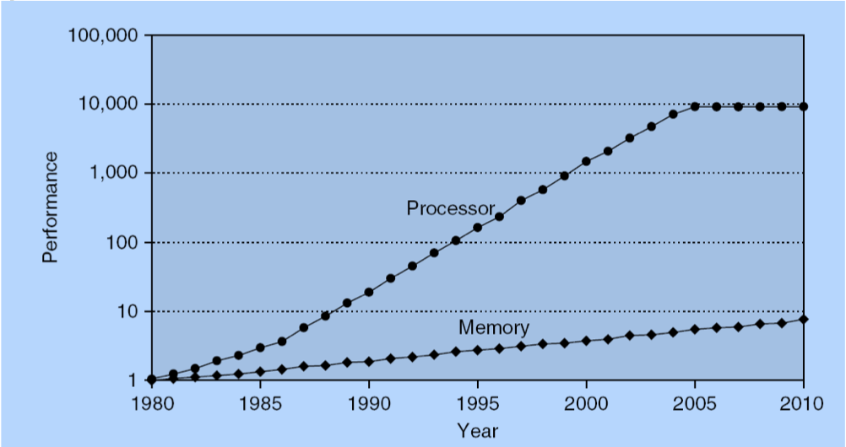
Memory-Density/Core-Density Declining…
(Hennesey/Patterson)

Slide 7
Traditional virtualization…
Virtual Machines sharing a server
Virtual Machine
Virtual Machine
Virtual Machine
Virtual Machine
Virtual Machine
Virtual Machine
This is not what we do!
Physical Machine

Slide 8
TidalScale virtualization
Virtual Machine sharing multiple servers
Virtual Machine
This is what we do!
Physical Machine
Physical Machine
Physical Machine
Physical Machine
Physical Machine
Physical Machine

Slide 9
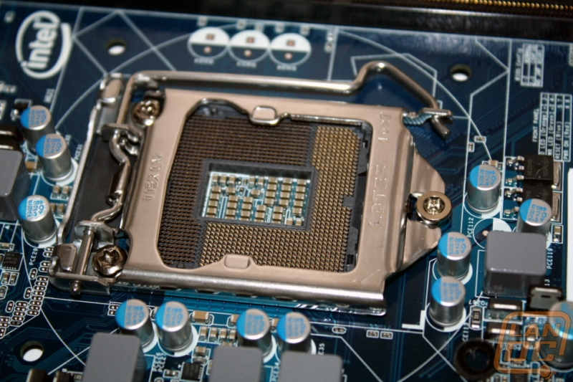
Memory-Density/Core-Density Declining…

Slide 10
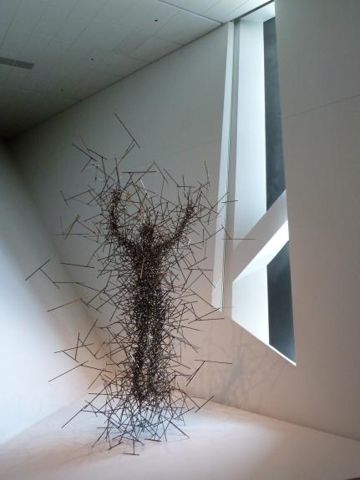
Working Sets – Processor and Memory Affinity
Over 50 years ago we figured out how to virtualize memory using working set locality*
Today, locality is applied ubiquitously across our computing infrastructure
TidalScale applies locality to all compute resource types automatically & dynamically across physical machines
We think in terms of memory hierarchies in a consistent way
We think of physical DRAM as an L-4 cache of the VM
In fact, it’s a cache-only architecture
* P.J. Denning

Slide 11
What about migration and decision overhead?
Application
Database
Operating System
Exit
Hyper
Kernel
Hyper
Kernel
Hyper
Kernel
Hyper
Kernel
Hyper
Kernel
…
HW
HW
HW
HW
HW

Slide 12
Rethinking DRAM from the SW Point of View
Where is the DRAM? Answer: It depends on your point of view:
From the host point of view (i.e. HW), the physical motherboard.
From the guest point of view (i.e. OS), it’s also on a motherboard, but that motherboard is virtual.
From the guest point of view, “physical” DRAM is actually a cache of host memory.
In other words, guest DRAM is a cache. It’s an all-cache design.
Guest
Application Software
Application Software
vCPU
Operating System
Operating System
vCPU
RAM
vCPU
RAM
vCPU
RAM
RAM
RAM
RAM
RAM
Virtual
Resources
RAM
CPU
CPU
RAM
CPU
RAM
RAM
CPU
RAM
RAM
RAM
RAM
HyperKernel
Physical
Resources
RAM
HyperKernel
HyperKernel
HyperKernel
Dedicated private interconnect
Host
Notes:
Under the covers, TidalScale uses machine learning to automatically co-locate compute entity with the resources it needs. And just like ordinary virtualization it does all of this transparently - the OS and applications have no idea they aren't running on hardware....

Slide 13
All-Cache Architecture Implications
Modern caches are hierarchical: L1, L2, L3. TidalScale technology effectively introduced L4.
All the memory on the motherboard is treated like any other cache (L4) except for one thing: the L4 cache is all the memory on the motherboards and is therefore HUGE, generally ~0.5TB - 2TB per server!
From a software point of view, each cache level must treat memory the same way. All references to memory must preserve Intel store order and strong cache coherency semantics.
Under these ground rules, nothing prevents additional levels of cache hierarchy.
Page mapping is handled by using 2nd level dynamic address translation hardware in modern microprocessors

Slide 14
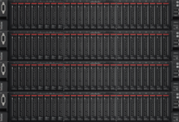
Under the Hood
One software-defined server
Application Software
vCPU
Operating System
vCPU
RAM
Software-Defined Servers
vCPU
RAM
vCPU
I/O
RAM
I/O
RAM
I/O
I/O
Multiple physical servers
CPU
CPU
RAM
CPU
RAM
I/O
Bare Metal Servers
CPU
RAM
I/O
RAM
I/O
Inverse-Hypervisor
I/O
Inverse-Hypervisor
Server 4
Inverse-Hypervisor
Server 3
Inverse-Hypervisor
Server 2
Server 1

Slide 15
Under The Hood (move the definition of memory?)
Memory page migration
Application Software
vCPU
Operating System
vCPU
RAM
vCPU
RAM
vCPU
I/O
Uses 2 levels of hardware based dynamic address translation
Migrates vCPUs and memory transparently to the guest OS
Dynamically and automatically load balances
Self-optimizing using ML
No central control
How?
RAM
I/O
RAM
I/O
I/O
CPU
CPU
RAM
CPU
RAM
I/O
CPU
RAM
I/O
RAM
I/O
Inverse-Hypervisor
I/O
Inverse-Hypervisor
Server 4
Inverse-Hypervisor
Server 3
Inverse-Hypervisor
Server 2
Server 1

Slide 16
Under The Hood (or move the processor?)
Virtual CPU migration
Application Software
vCPU
Operating System
vCPU
RAM
vCPU
RAM
vCPU
I/O
Uses 2 levels of hardware based dynamic address translation
Migrates vCPUs and memory transparently to the guest OS
Dynamically and automatically load balances
Self-optimizing using ML
No central control
How?
RAM
I/O
RAM
I/O
I/O
CPU
CPU
RAM
CPU
RAM
I/O
CPU
RAM
I/O
RAM
I/O
Inverse-Hypervisor
I/O
Inverse-Hypervisor
Server 4
Inverse-Hypervisor
Server 3
Inverse-Hypervisor
Server 2
Server 1

Slide 17
Nodes, Memory and Processors
The virtual machine aggregates the processors, all the memory, all the storage, all the Ethernets (except for a private interconnect that we treat more as a system bus than a network).
We treat the resources as virtual and mobile. The hyperkernel binds the virtual resources to physical resources on demand.
There is no master node and no shared state in the hyperkernel. Scheduling is distributed. Therefore, no single point of failure.
We use the hardware virtualization extensions. The OS uses the first level page tables, the hyperkernel manage the second level page tables.
Processor migration is fast!
Memory is strongly cache coherent. There can be multiple copies of read only pages across the cluster. On a page write, we do the necessary invalidation, TLB management, etc. Copy on write is supported. Intel store order is preserved.
The HK sits beneath the OS and above the hardware. The VM looks like hardware to the OS (which is in a dream state). The HK treats all OS’s the same.

Slide 18
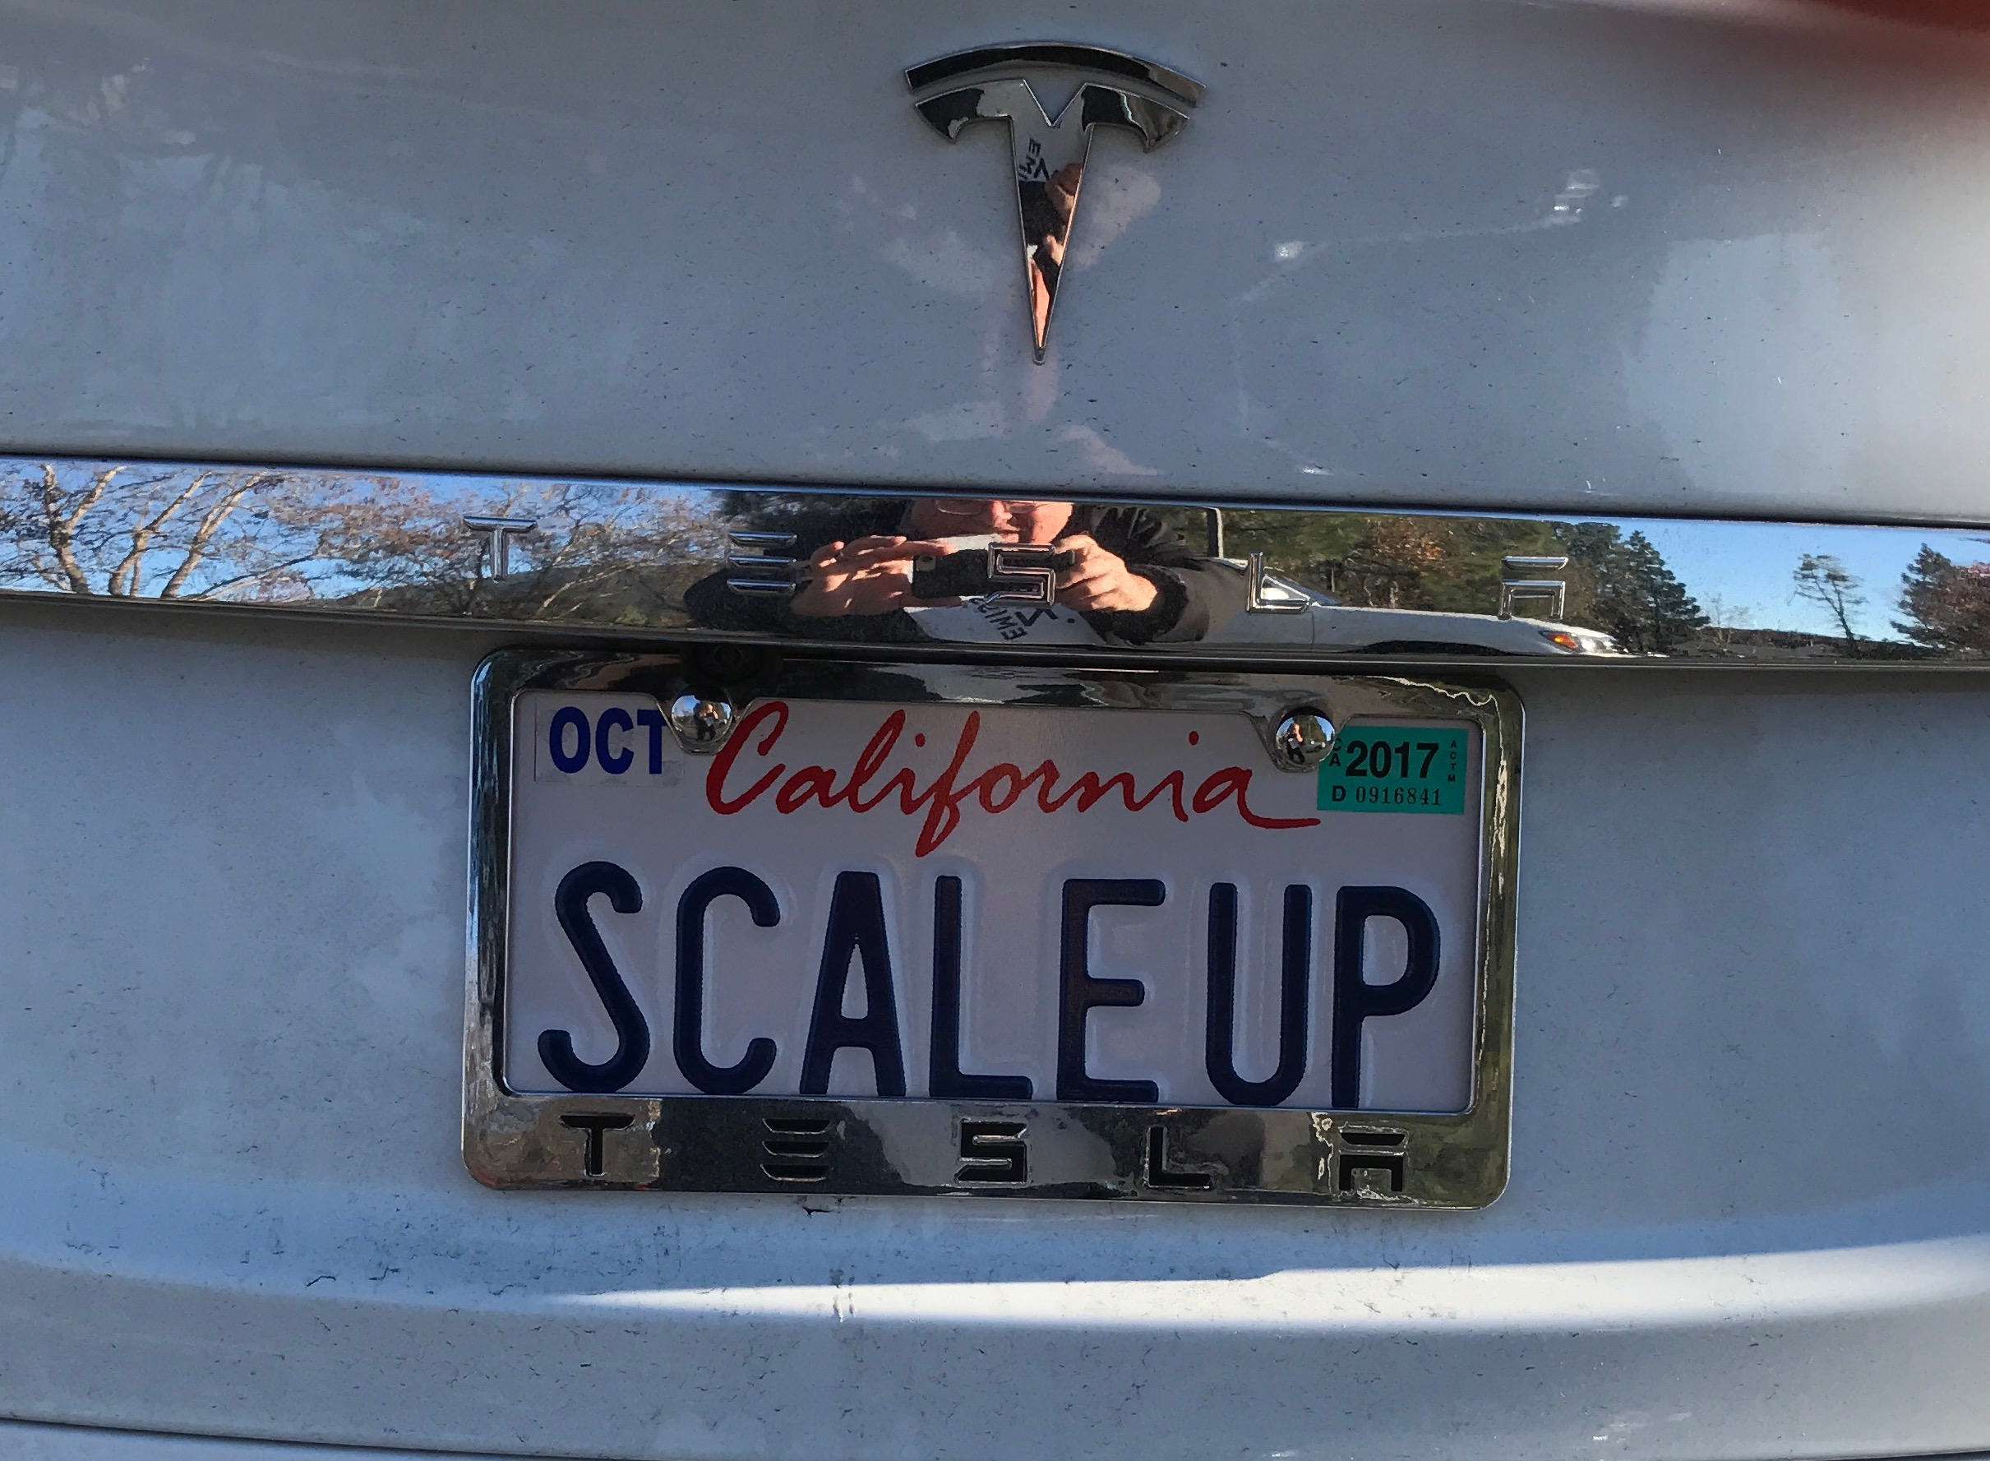
Up or Out? Best of Both Worlds
 | Scale Up | Scale Out | TidalScale
Software Simplicity | ✔ | ✗ | ✔
Hardware Cost | ✗ | ✔ | ✔

Slide 19
When the DVM is designed correctly, the OS and apps just run

Slide 20
Optimization Philosophy Based on ML
Guiding Principle:
Machines Operate Faster Than Humans. So let them.
Performance is dominated by the (largely unpredictable) pattern of access between processors and memory
The HyperKernel observes, adjusts, analyzes and adapts
Our goal was to build-in intelligence and machine-learning into the HyperKernel to automatically and dynamically monitor and optimize performance through introspection
This leads us to a model in which we track threads and working set locality

Slide 21
How? Multidimensional Strategic Decisions
Humans find it difficult to make decisions with multiple factors using different units
Example: I visit my cousin in Sebastopol. What strategy should I use to return home to Los Gatos? Take highway 880 or 101?
  Multiple factors and unit dimensions: (toll vs no toll, traffic pattern @ time-of-day, EV charging availability, stop to see my son in San Mateo, arrival time constraint, etc.)
Another Example: The Potato Paradox (cf: Wikipedia):
  Start with a bag of 100 pounds of potatoes, assume 99% water by weight, then dehydrate to 98%. How much does the bag weigh after dehydration?
  Initially we start with 99 pounds of water + 1 pound of potato matter = 100
  After dehydration to 98%, still have 1 pound of potato matter, but how much water?
  Total weight: water + potato
  X = .98X + 1
  Solving for X we have 1 = .02 X, therefore X=50
  The bag weighs 50 lbs! Who would have guessed this?

Slide 22
What about migration and decision overhead?
Overhead = # Stalls * average time/stall
Application
Database
Operating System
Exit
Hyper
Kernel
Hyper
Kernel
Hyper
Kernel
Hyper
Kernel
Hyper
Kernel
…
HW
HW
HW
HW
HW

Slide 23
A stall results in an interrupt (aka VMExit)
No stalls = no overhead. Machine speed.
Virtual vs. physical processors. Our scheduler maps v-cpus to p-cpus
Each stall is caused by an event that cannot be directly handled by the hardware
If the resource is not accessible, hardware generates an interrupt, then HK analyzes and handles it . The HK looks for a resolution strategy.
For each stall, there are constraint-based strategies - each defined by a non-linear weighted polynomial
          cost _{s1} = w₁•f₁^{i1} + w₂•f₂^{i2} + … + w_{n}•f_{n}^{in}
          cost _{s2} = w₁•f₁^{i1} + w₂•f₂^{i2} + … + w_{n}•f_{n}^{in}
          cost selected = min(costs)
  Note: It’s mostly multiplying and adding
  We update local state as strategy decisions are acted upon
  Hyperkernel instances negotiate with each other
  It’s continuously operating machine learning, with an infinite training stream, and self-tuning as it goes along. No stale information to manage or clean up.

Slide 24
Machine Learning
When a node makes a migration decision, we record what we did; i.e. we learn. As a result of uncertainty, we cannot require perfect knowledge of the overall state of the system.
We have several measures of performance. One example:
Goodness = net-guest-thread-execution-time / #stalls
[If goodness is low, we need to make decisions to
improve guest-thread execution time relative to #stalls]
To improve performance, threads accessing the same set of pages should be co-located with each other and with the pages they reference.
At the same time, it’s probably a bad idea to break up working sets that are working well.
But, there are exceptions to everything.

Slide 25
Treatment of I/O
Reminder: We choose to never modify the OS
The Guest Operating System runs as if all I/O were local – a virtual motherboard (except remote FS)
But, it’s a distributed system. We can virtualize I/O devices and use existing distributed file system techniques in addition to manipulating PTE’s and moving guest pages to nodes containing physical devices.
The interconnects today are fast
We use several techniques:
  Remote execution of I/O
  Remote I/O buffers
  Remote interrupt delivery
  Chained I/O ops to minimize OH
  Manipulation of 2nd level PTE’s
  Migration of processors
  Migration of completed buffers
  Asynchronous I/O when possible
  Event-driven I/O
  Deferred I/O completion

Slide 26
Problem: Firewalled Schedulers
The problem is that none of these levels know or can know anything about the other levels. They are hidden from each other, and therefore could interfere with another layer!
Processor Microcode
Host OS Scheduler
TidalScale Scheduler
Guest OS Scheduler
DB Scheduler
Intra-process app scheduler

Slide 27
An Example
Assume a virtual processor P₁ is running a guest thread T₁ on node N₁ and then stalls. During the time of the stall, or upon completion of the stall, the OS might decide behind our back to reschedule T₁ onto a different processor P₂. But suppose P₂ is running on a different node, say N_{2.} The problem just introduced is this: All the pages that T₁ had been using are likely on N₁ but now T₁ is on N₂. If T₁ continues to use those pages, the system could thrash, unnecessarily dragging many pages across the interconnect to co-locate the pages needed by T₁ (now running on P₂) onto node N₂.

Slide 28
One Solution
When a virtual processor wakes up after a stall to start running guest code (either OS or application) the virtual processor could immediately check to see that the stack pointer is pointing at a page that is resident on the node on which that virtual processor is running. If so, we continue. But if not, we might want to immediately migrate the virtual processor back to where the thread had been running before the stall. The OS doesn’t need to know!

Slide 29
Page Migration AND Processor Migration
Both are necessary
If all the data cannot fit in one server,
  we distribute it among multiple servers
But if we then scan through all the data in all the guest memory
  We might have to move a lot of memory around. This is slow.
But we have “wandering cpu’s”!
  The cpu’s move to where the data is, which can be much faster.

Slide 30
Oracle 18c: Star Schema Benchmark, Scale Factor 1500
TidalScale Performance
Bare-Metal Server
Quad Socket, Intel V5
48 Cores 768GB

Slide 31
Oracle 18c: Star Schema Benchmark, Scale Factor 1500
TidalScale Performance
Bare-Metal Server
Quad Socket, Intel V5
48 Cores 768GB
TidalScale
2 x Dual Socket, Intel V4
24 Cores 1536GB
2.5X Faster

Slide 32
Oracle 18c: Star Schema Benchmark, Scale Factor 1500
TidalScale Performance
Bare-Metal Server
Quad Socket, Intel V5
48 Cores 768GB
Queries / $
1X
TidalScale
2 x Dual Socket, Intel V4
24 Cores 1536GB
2.5X Faster
5X
TidalScale
2 x Dual Socket, Intel V4
24 Cores 1536GB
With Oracle “In-Memory”
20X Faster
30X

Slide 33
Reliability, Resiliency, and Compatibility
Hardware compatibility must be 100%. We achieve this by being virtually indistinguishable from hardware, and we run over 1500 server hardware acceptance tests (e.g. LTP). The OS thinks it’s running on hardware, and applications only know the OS on which they’re running.
Our SW reliability must be 100%.
But HW reliability is never 100%. In the earlier years, this was troubling. If one node fails, why wouldn’t it bring the entire software-defined-server down?
But fortunately, it turns out there is a very elegant solution to this problem in which all servers become hot-swappable; this is due to existing abilities which can migrate redundant resources if impending hardware failures are detected through telemetry.

Slide 34
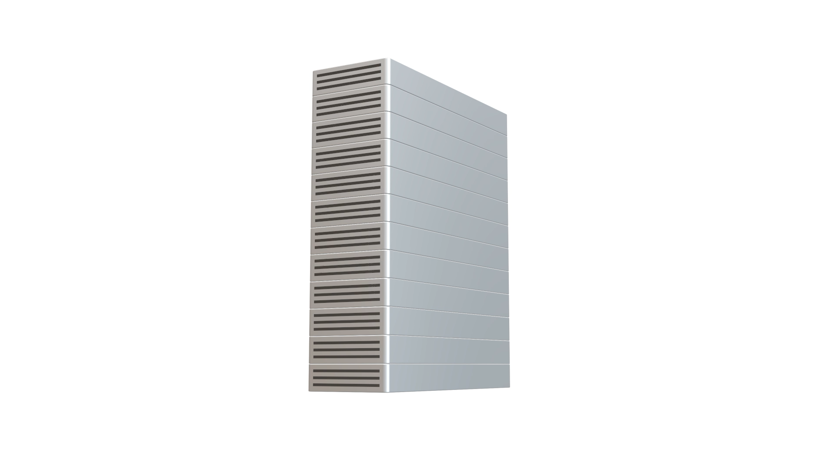
Introducing TidalGuard®
Patented

Slide 35
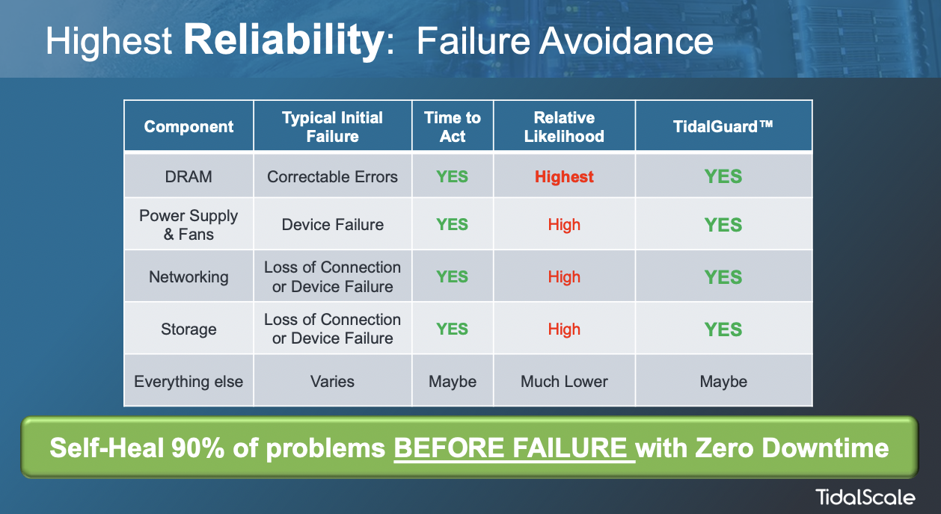
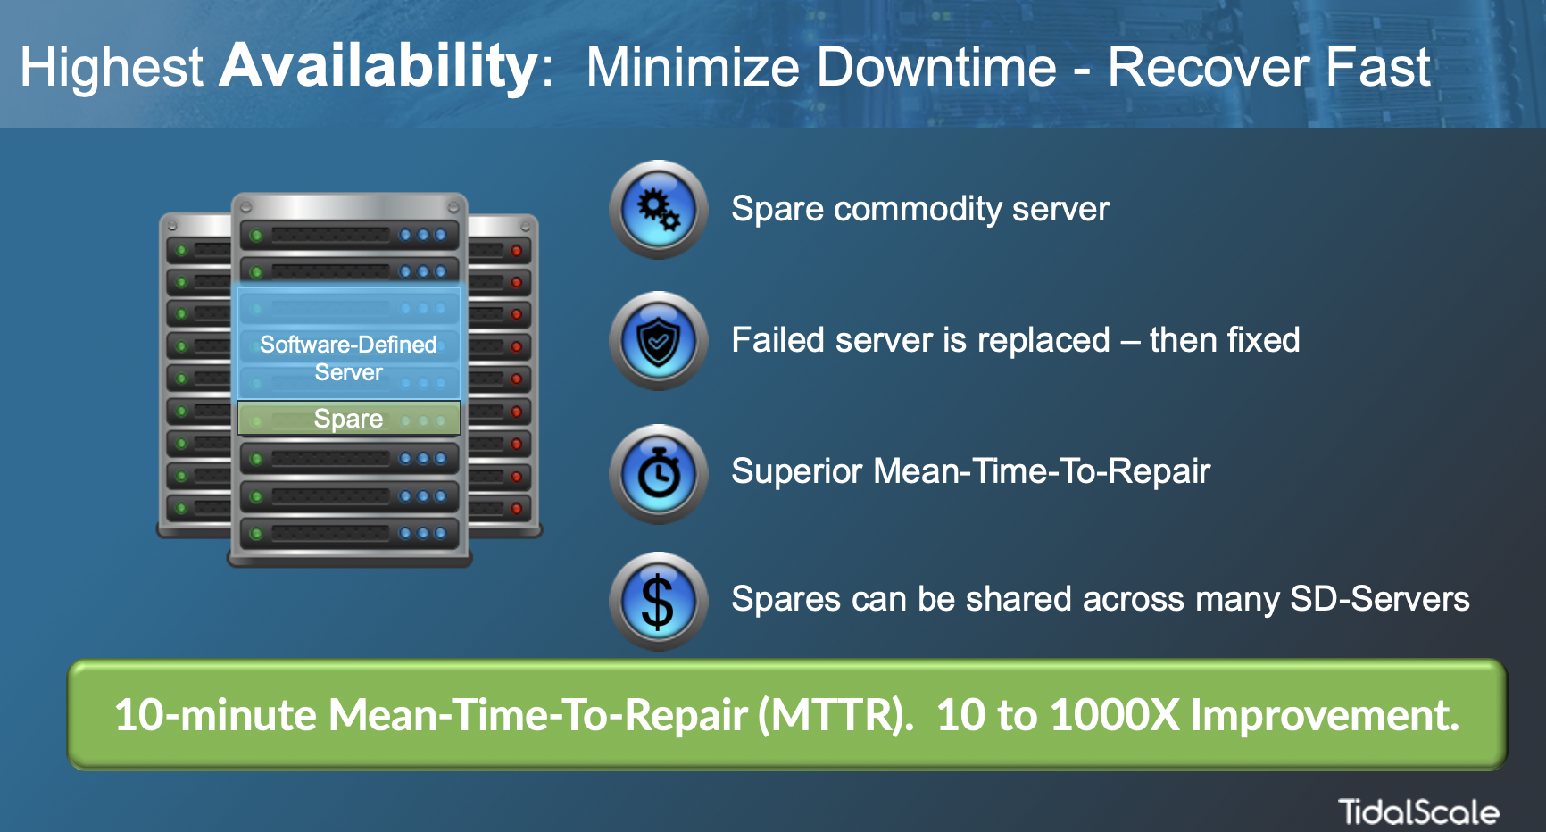
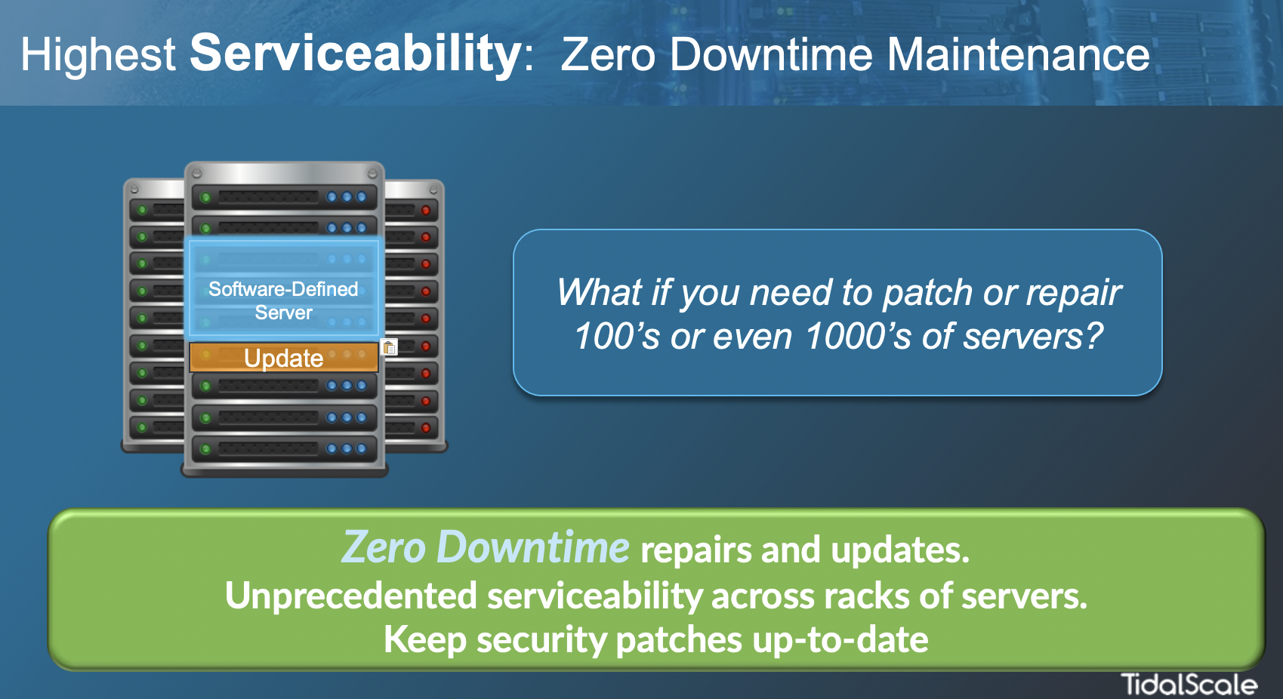

Add Two 9’s to System Uptime
100X Improvement

Slide 36
Pre-CXL Memory Appliance Proof of Concept
Objective
  Demonstrate that a Server connected to a Memory Appliance can outperform the same Server with no additional memory
  Do it over a weekend
  Use standard unmodified application and benchmarks
  Use an off the shelf Oracle Database running standard TPC-H Benchmark

Slide 37
Oracle TPC-H: BareMetal Server vs. Server + NAM
DOES NOT RUN – Insufficient Memory
seconds

Slide 38
Oracle TPC-H: BareMetal Server vs. Server + NAM
Row Store (RS) vs. Column Store (CS)
DOES NOT RUN – Insufficient Memory
1.8X Faster
3.4X Faster
seconds

Slide 39
Benefits
Scalable development and operational environment
  Need more memory or processors? Add / Test in Minutes
  Developers can build, test, and deploy against a performance target
Scale the server to your problem, rather than scale the problem to the server
  No longer need to scale your problem to your server!
  Size the server you need to the current requirement
Automation
  Allow the machine automatically to scale itself up or down
  The server exactly matches the performance needs
  License the SW only for what you need, when you need it
  Saves $$ by only using what you need, when you need it
You can choose: On-premise or in the Cloud

Slide 40
Summary
It’s important to rethink some fundamental assumptions (counter-factual thinking)
How it works
OS and application compatibility
Performance
Reliability/High Availability
Increase deployment options
Anticipates Memory Appliances

Slide 41
“This is the way all servers will be built in the future”
- Gordon Bell
Programming an Application When Memory Size Is No Longer A Constraint, IEEE Computer, August 2017
Revisiting Scalable Coherent Shared Memory, Bell and Nassi, IEEE Computer, Special Issue: Outlook 2018, January 2018
Scalable Computing Systems for Future Smart Cities, IET Smart Cities 2022;1–2

